Slide 1
Big Mountain Ski Resort
Lift Ticket Pricing

Slide 2
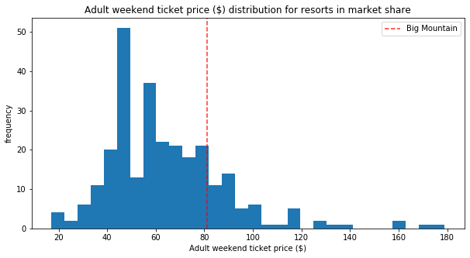
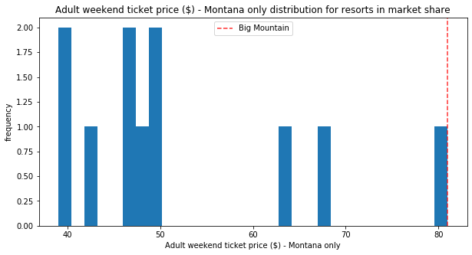
How should Big Mountain determine the price of a lift ticket?
Notes:
Currently, Big Mountain is operating with more premium amenities than Montana’s other ski resorts. As such, they are able to and have charged more for ticket prices at 81 dollars for an adult weekend lift ticket.
This makes Big Mountain one of the more expensive resorts in the U.S. (click)
And THE most expensive resort in Montana (click)
This strategy has worked because (click) Big Mountain exceeds most of the competition in premium amenities.
But there is a more accurate way to price tickets that could make Big Mountain more revenue each year and provide insight into the effects of adding and removing amenities.

Slide 3
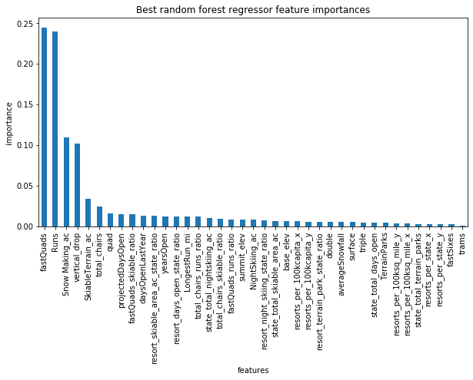
Random Forest Regression Pricing Model
$81 to $90.87
Additional $17,500,000 in revenue.
Notes:
Using a random forest regression model, we can compare amenities of ski resorts across the country to predict the price of lift tickets.
This model predicts ticket prices with an error of around 9 dollars. Big Mountain’s predicted ticket price is 90.87. Almost ten dollars more than actual price. Charging this much could increase revenue by 17,500,000. (click)
These are the features the model uses to determine ticket price. The bars measure the importance each feature is to the price. Many of the most important features are amenities which Big Mountain outperforms the competition.

Slide 4
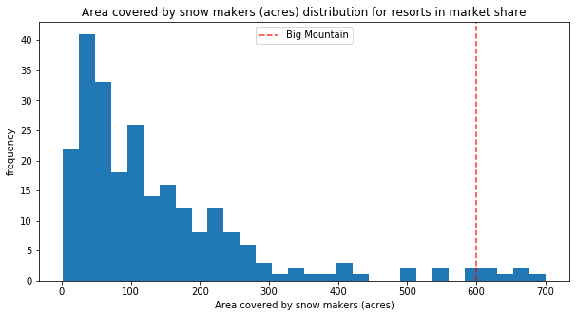
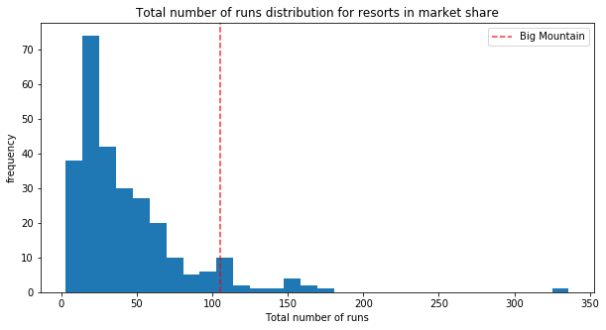
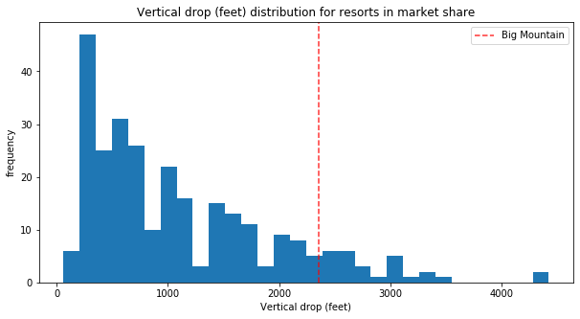
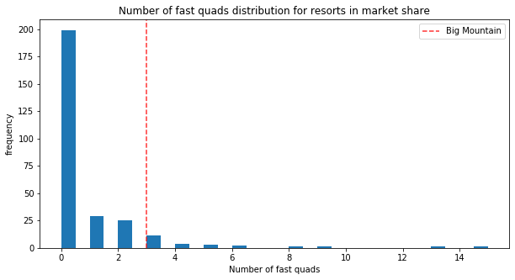
Notes:
Big Mountain is above average in the top four features that determine price: Snow Making, Number of Runs, Vertical Drop and Number of Fast Quads.

Slide 5
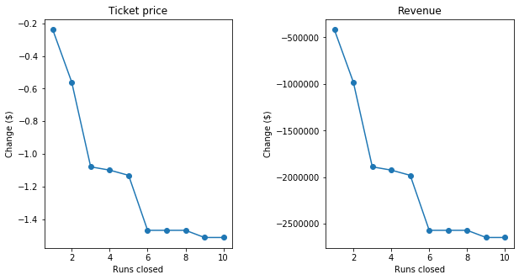
Removing Runs
Notes:
Can Big Mountain remove runs and still charge the same for tickets?
Maybe(click)
Depending on the cost of keeping runs open, this could be a good strategy to save money. Closing one run does not appear to have an affect on the predicted price of tickets. This changes rapidly. The graphs show its most cost effective to close 1, 5, or 10 runs. But only if operating costs are relatively high. Closing more than 1 run will result in a loss of at least 1 million in revenue.

Slide 6
Additions
New Run and a New Chair Lift that Increases Vertical Drop
Could Increase Revenue by $1463000.
Previous Chair cost 1500000 to run.
Added Snow Making to New Run
The two acres of additional snow making is not enough to change predicted price.
Increasing Longest Run and Adding Four Acres of Snow Making
Not enough to affect price.
Notes:
One proposition was to add a new chair lift with a new run that would increase the total vertical drop at Big Mountain. These are all features that the model prioritizes and indeed could increase revenue, but it may not be enough.
Another was to add two acres of snow making. But this isn’t enough to make a difference.

Slide 7
Conclusion
Strong model for predicting the effects changing amenities at Big Mountain.
More Data/consultation for exact ticket price.
Resorts proximity to major airports? Major cities? Other resorts?

